Slide 1


2023-081
Improving Cognitive Independence of Dementia Patients Using Machine Learning Enabled Mobile Application
PRESENTED BY | 2023-081
PRESENTED ON | 04/09/2023

Slide 2





Introduction

Slide 3
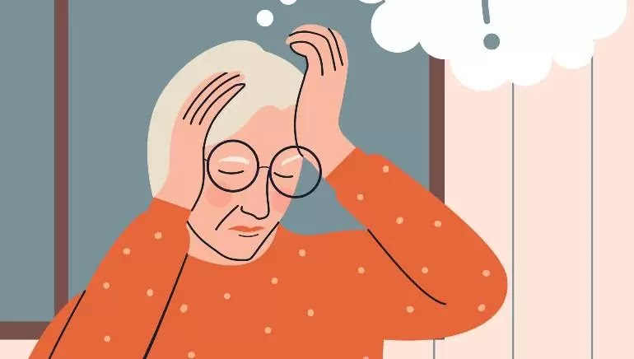
What Is Dementia?
Dementia patients are individuals who have a decline in their cognitive and memory abilities that interferes with their daily life and activities. It is a progressive condition that affects thinking, memory, behavior, and the ability to perform everyday activities.

Slide 4

35.6 Million
Worldwide Population with dementia with an increase of
7.7 Million
New cases every year
By 2030
It is projected to be doubled

Slide 5
Research Problem

Slide 6

Lack of accessibility options in available tools
Affects the quality of life
Affording a caregiver is costly
Lack of resources in available mediums
Caregivers lack the expertise to handle the patient
Caregivers cannot always be available, whenever needed

Slide 7
Research Objectives
To explore and identify the feasible solutions to develop a smart solution to improve the quality of life and independence of Dementia patients
Analyze wandering and predict future movement.
Maintain a digital diary via voice recognition for mental stability.
Feelings detection mechanism to provide musical therapy sessions.
Face recognition system to detect loved ones and relatives.

Slide 8
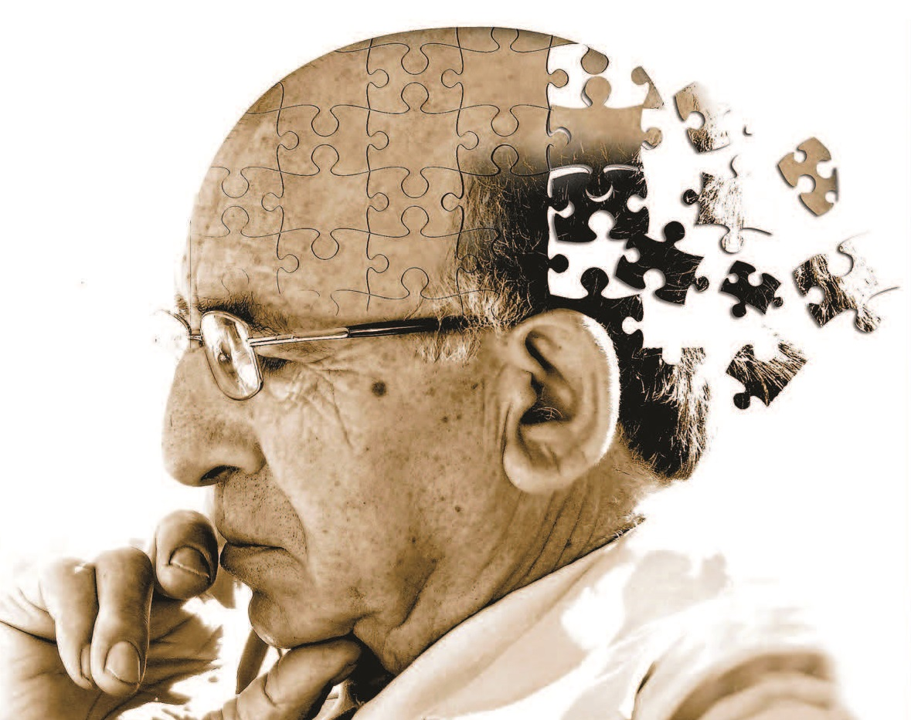
Overall System Diagram

Slide 9
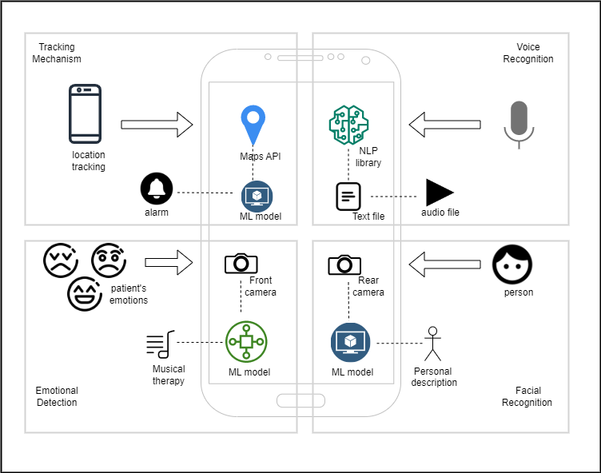

Slide 10
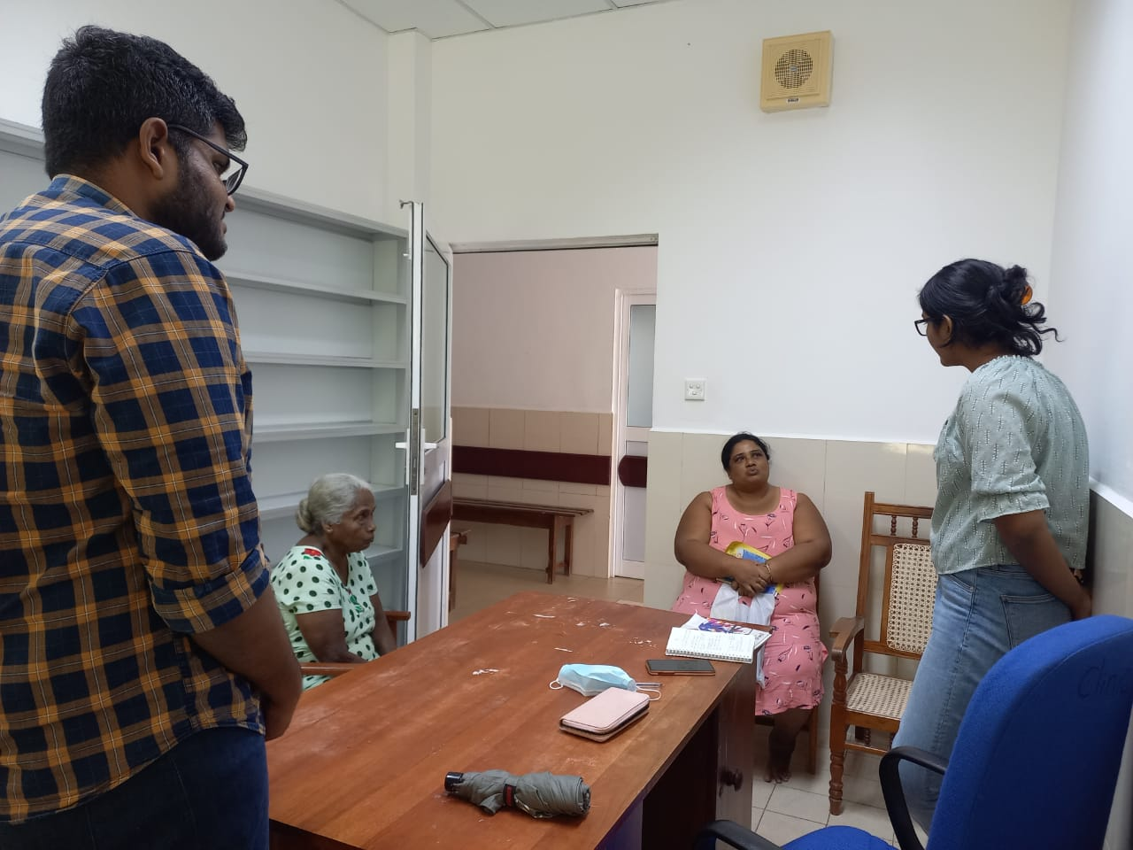
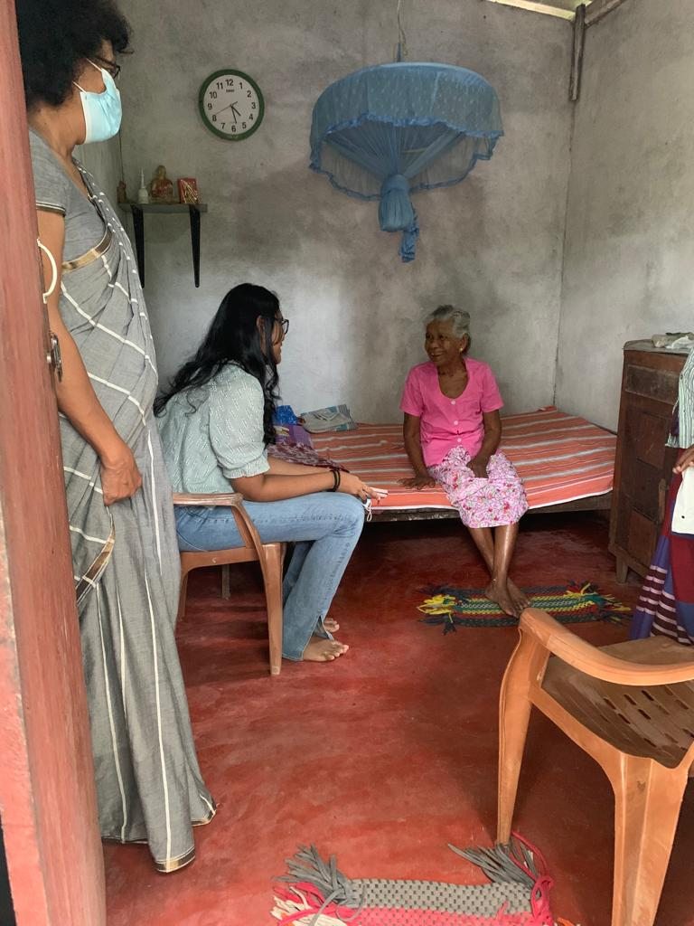
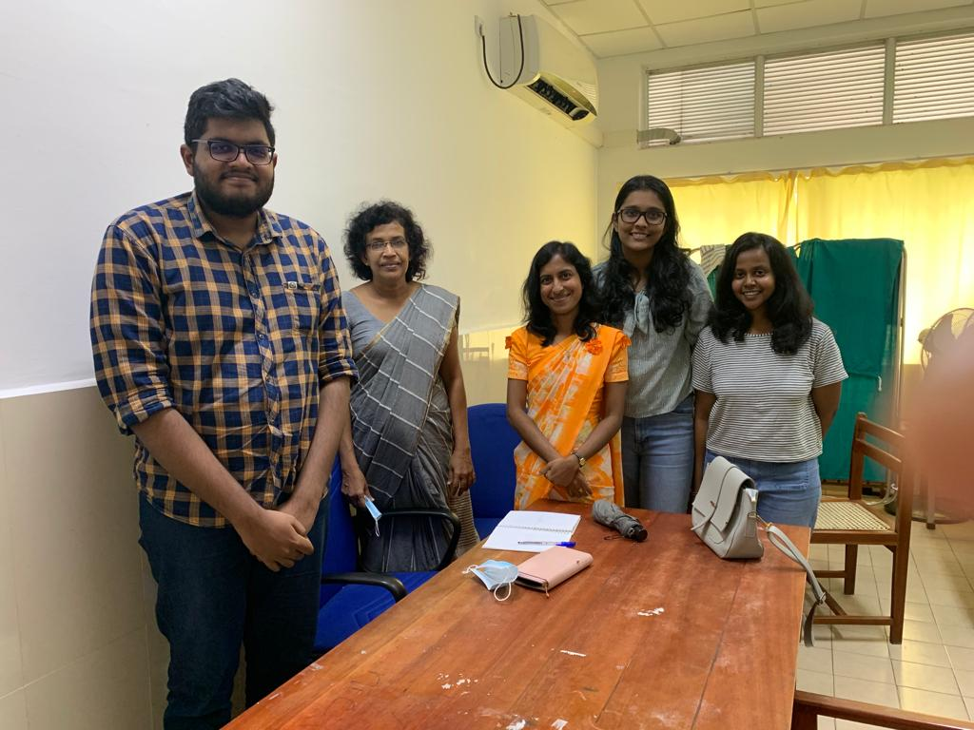
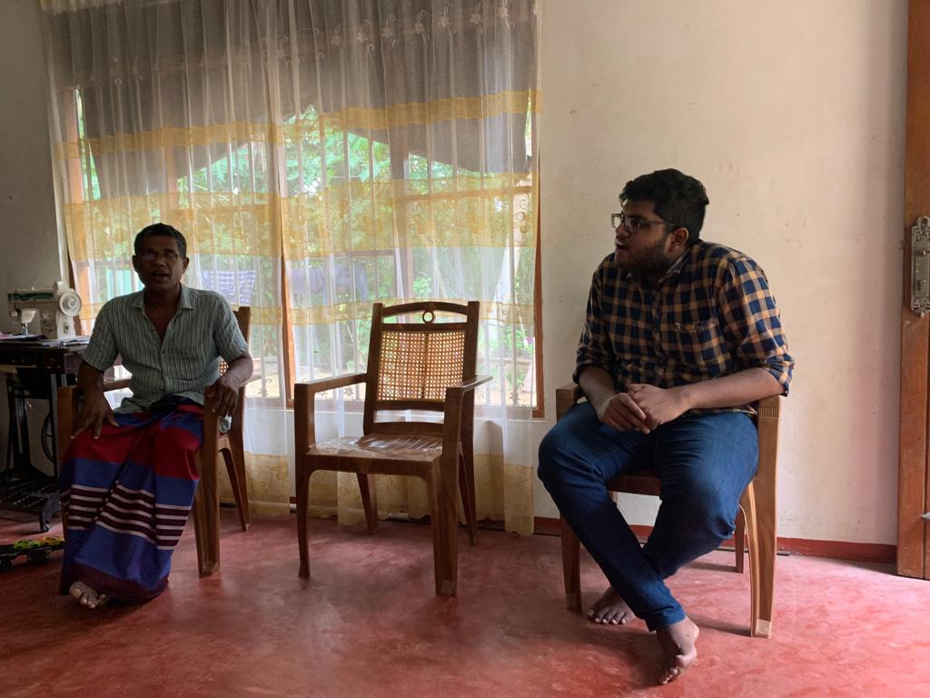
Hospital and site Visits

Slide 11
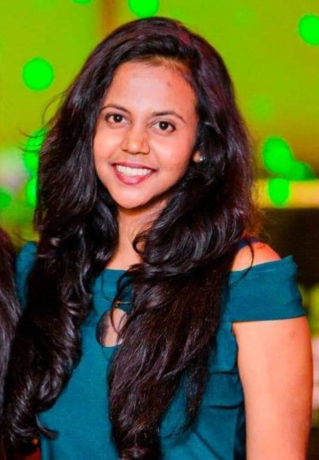
Jayasinghe J.M.S.U.
IT20034740
BSc (Hons) in Information Technology (Specialization in Software Engineering)
Providing a smart solution by using voice recognition and NLP to maintain a digital audio diary by a patient as journalism helps to keep stability of memory
IT20034740 | Jayasinghe J.M.S.U. |2023-081

Slide 12
Research Problem
Forgetting daily tasks
Social isolation
Difficulties in communication
Frustrations and stressful behavioral patterns
Lack of literacy and poor vocabulary
Depression and anxiety
IT20034740 | Jayasinghe J.M.S.U. |2023-081

Slide 13
Research Gap
Personal Journal Keeping and Linguistic Complexity Predict Late-Life Dementia Risk [1]
Modifying the Diary Interview Method to Research the Lives of People With Dementia [2]
AN INDEPENDENT EVALUATION OF ‘DEMENTIA DIARIES’ [3]
IT20034740 | Jayasinghe J.M.S.U. |2023-081

Slide 14


 | A | B | C | Solution
Including audio recordings of patients
Usage of voice recognition
Speech to text conversion and storage of text files
Speech summarization
A - [1]
B - [2]
C - [3]
IT20034740 | Jayasinghe J.M.S.U. |TMP-23-081

Slide 15
Speech recognition and voice detection
Research Objectives
Converting speech to text using NLP transformers to ease maintaining diaries
Improving the cognitive independence and wellbeing of dementia patients by motivating them to maintain a digital audio diary.
Prediction of summarized texts
IT20034740 | Jayasinghe J.M.S.U. |2023-081

Slide 16
Methodology
IT20034740 | Jayasinghe J.M.S.U. |2023-081

Slide 17
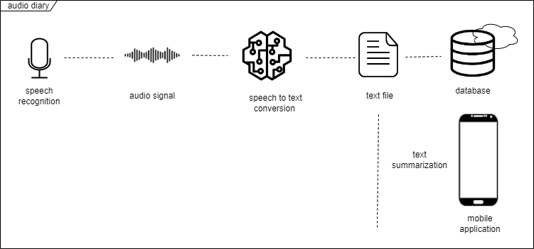
System Overview Diagram
IT20034740 | Jayasinghe J.M.S.U. |2023-081

Slide 18




Tools and technologies
React Native
GitLab
Firebase
Python
IT20034740 | Jayasinghe J.M.S.U. |2023-08181

Slide 19
Evidences for the Completion
IT20034740 | Jayasinghe J.M.S.U. |2023-081

Slide 20
Voice to text conversion and Text summarization
Linear Predictive Coding (LPC)
Pre processing in feature extraction of voice
React native voice library
NLP transformers for text summarization
BART model hugging face
Dataset used - cnn_dailymail
IT20034740 | Jayasinghe J.M.S.U. |2023-081

Slide 21
Tasks to be completed
Integrate and test the whole system together
Commercialize the application
IT20034740 | Jayasinghe J.M.S.U. |2023-081

Slide 22
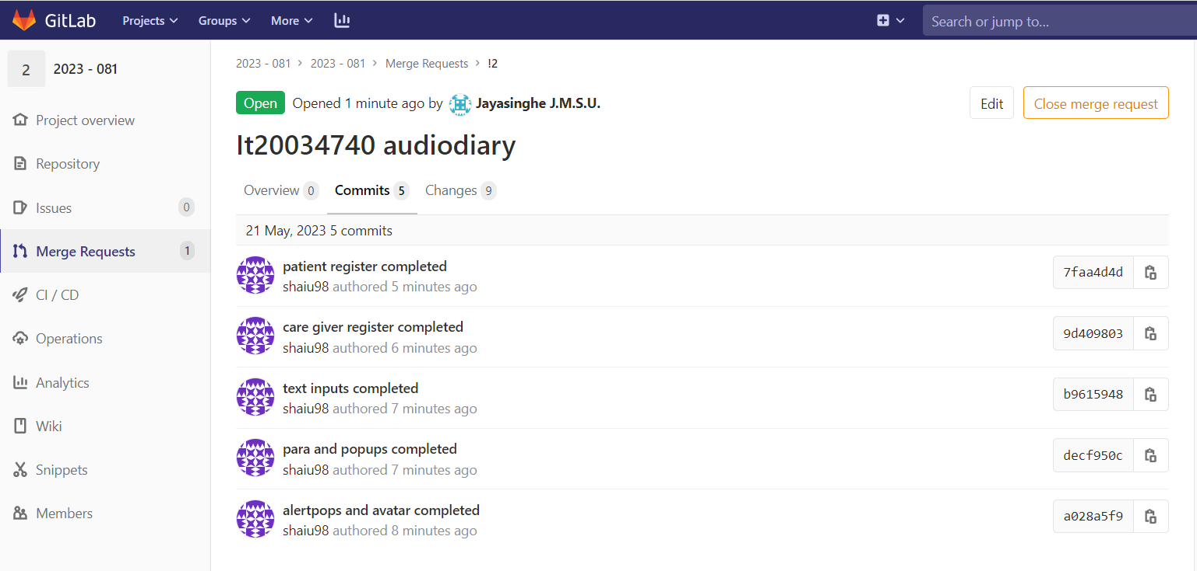
Gitlab Repository
IT20034740 | Jayasinghe J.M.S.U. |2023-081

Slide 23
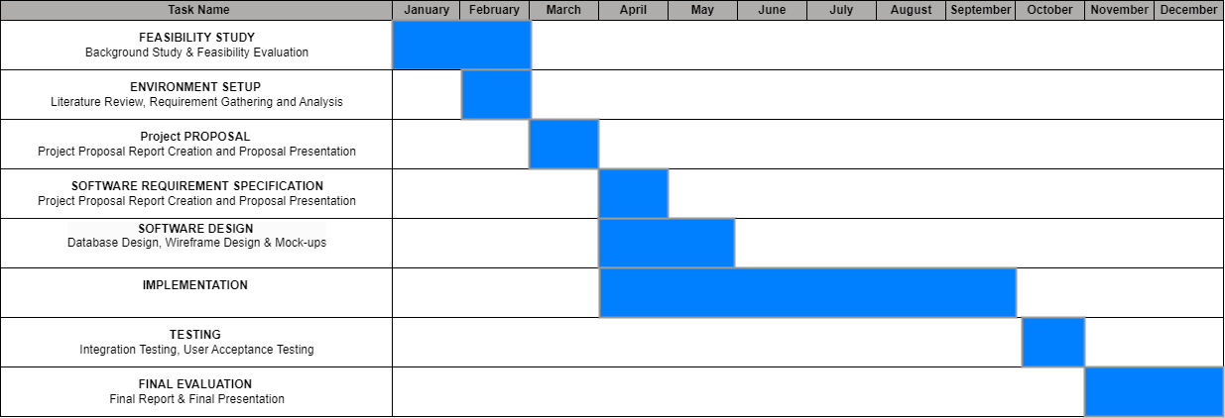
Gantt Chart
IT20034740 | Jayasinghe J.M.S.U. |2023-081

Slide 24
Work Breakdown Structure
Improving the cognitive independence and wellbeing of dementia patients by motivating them to maintain a digital audio diary.
Feasibility Study
Requirement Analysis
Design
Implementation
Testing
Documentation
Identifying the problem
Gather Requirements
System Design
Implementation of voice recognition and speech to text conversion
Unit Testing
Project Charter
Design s Solution
Analize Requirements
Interface Design
Implementation of generated text based mechanisms
Integration Testing
Project Proposal
Literature Review
Well Optimized
User Acceptance Testing
Research Paper
System Testing
Final Report
IT20034740 | Jayasinghe J.M.S.U. |TMP-23-081

Slide 25
References
[1] Personal Journal Keeping and Linguistic Complexity Predict Late-Life Dementia Risk: The Cache County Journal Pilot Study, Jessica J. Weyerman, Cassidy Rose, and Maria C. Norton
[2] Modifying the Diary Interview Method to Research the Lives of People With Dementia, Ruth Bartlett, originally published online 3 October 2012
[3] An independent evaluation of ‘Dementia Diaries’. Woodall, J and Surr, C and Kinsella, K and Bunyan, A (2016)
IT20034740 | Jayasinghe J.M.S.U. |2023-081

Slide 26
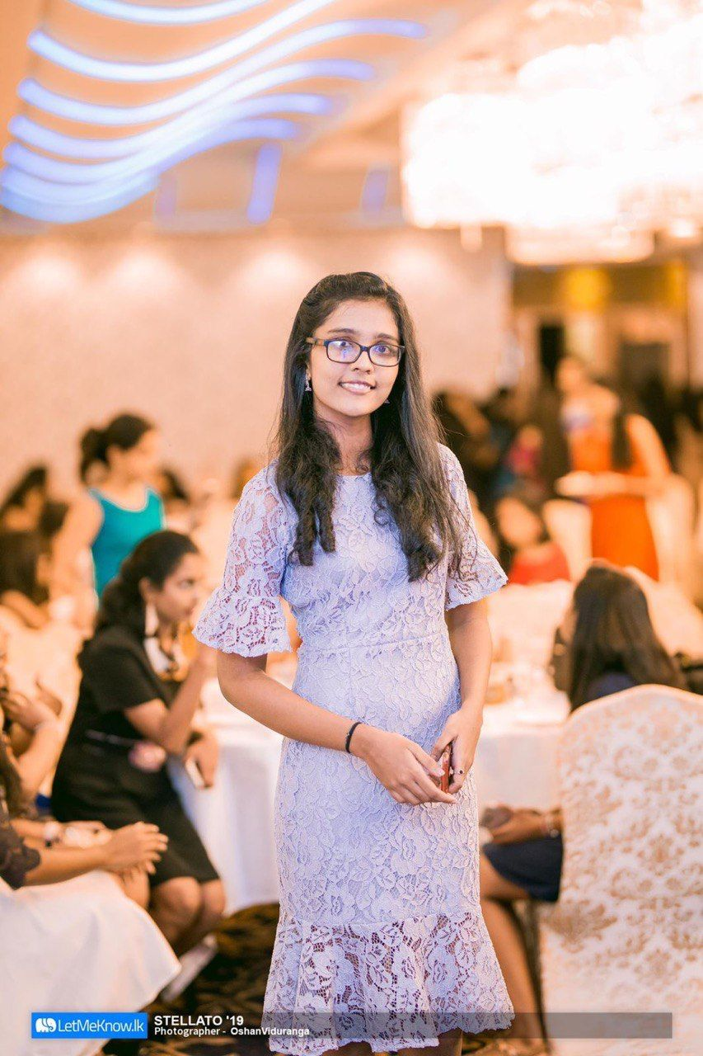
Hiththatiyage D.K
IT20162696
BSc (Hons) in Information Technology (Specialization in Software Engineering)
Improving cognitive independence of dementia patients by directing them to the appropriate music therapy sessions while analyzing their emotional state
IT20162696 | Hiththatiyage D.K |TMP-23-081

Slide 27
Research Problem
Inability to control emotional changes
Emotional responses frequently vary
Caregivers lack the expertise to assist patients
Third prty not being available all thetime
Existing tools lacks the accessibility for dementia patients
Music recommendations are ineffective in elevating mood
IT20162696 | Hiththatiyage D.K |TMP-23-081

Slide 28
Research Gap
Real-time EEG-based emotion recognition for music therapy [2]
Alive Inside: Developing mobile apps for the cognitively impaired[3]
Emotion Based Music Player[1]
IT20162696 | Hiththatiyage D.K |TMP-23-081

Slide 29
 | A | B | C | Solution
Assist emotion feature extraction
Detect age and classify music separately
Visual Presentations accordance with the classified music
Build a music library based on real time patient reaction
optimized for mobile/ cloud use
A -Music Player
B - EEG
C - Alive Inside
IT20162696 | Hiththatiyage D.K |TMP-23-081

Slide 30
Training the Dataset
Research Objectives
Detecting the emotion using the model
Improving cognitive independence of dementia patients by directing them to the appropriate music therapy sessions while analyzing their emotional state
Choosing the appropriate therapeutic music session using an emotion-audio integration module
IT20162696 | Hiththatiyage D.K. |TMP-23-081

Slide 31
Methodology
IT20162696 | Hiththatiyage D.K |TMP-23-081

Slide 32
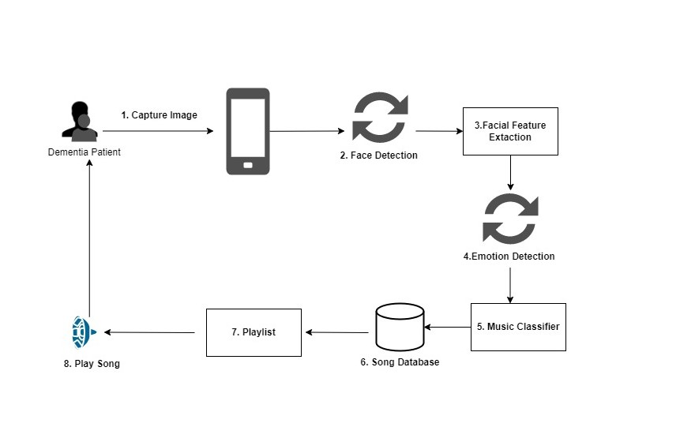
System Diagram
IT20162696 | Hiththatiyage D.K. |TMP-23-081

Slide 33

Tools and technologies
React Native
Tensorflow + keras
Firebase
Numphy
Python
Pandas
GitLab

Slide 34
Evidences for the Completion
IT20162696 | Hiththatiyage D.K |TMP-23-081

Slide 35
EMOTION DETECTION MODEL
Fer2013 Dataset - It is a publicly available facial expression recognition dataset. It contains a collection of images of human faces, each labeled with one of seven different facial expressions: anger, disgust, fear, happiness, sadness, surprise, and neutral
Approximately 35,887
Training Data: 28709
Validation Data: 3589
Testing Data: 3589
Convolution Neural Network (CNN) using keras framework
Sequential model with several layers (Conv2D, Dense)
Batch normalization and ReLU activation functions helps stabilize training and improve the model's ability to learn from the data.
IT20162696 | Hiththatiyage D.K |TMP-23-081

Slide 36
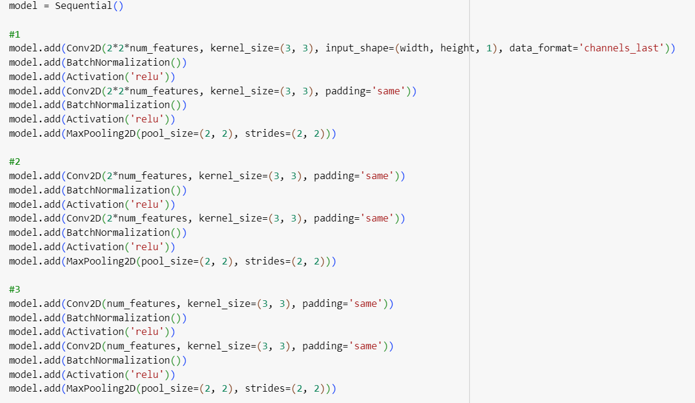
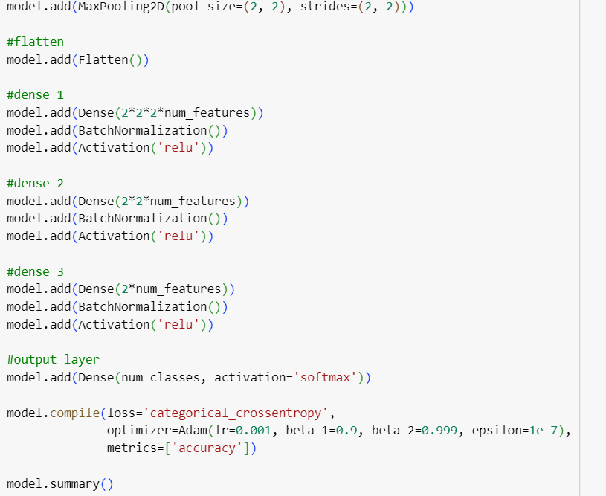
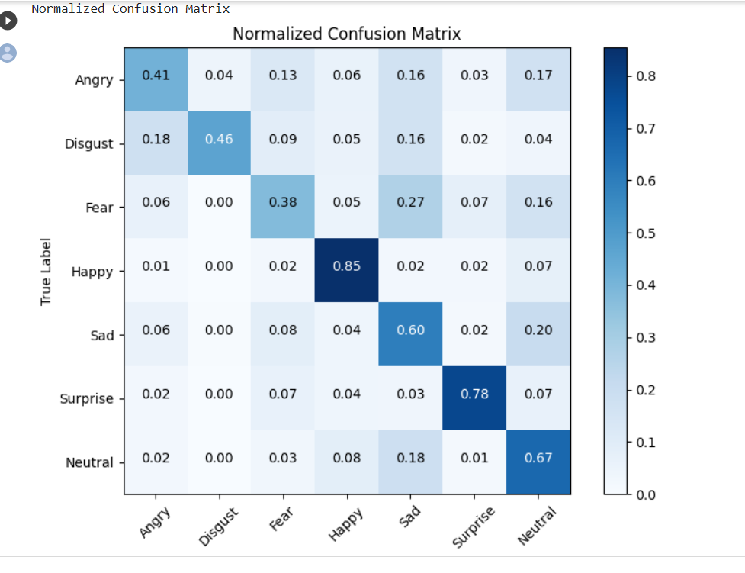
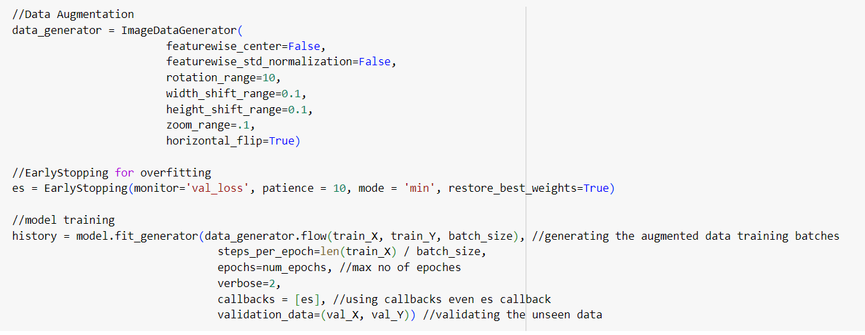

Slide 37
Tasks to be completed
Integrate and test the whole system together
Commercialize the application
IT20162696 | Hiththatiyage D.K |TMP-23-081

Slide 38
Gantt Chart
IT20162696 | Hiththatiyage D.K |TMP-23-081

Slide 39
Work Breakdown Structure
Improving cognitive independence of dementia patients by directing them to the appropriate music therapy sessions while analyzing their emotional state
Feasibility Study
Requirement Analysis
Design
Implementation
Testing
Documentation
Identifying the problem
Gather Requirements
System Design
Implement a Emotion Extraction Model
Unit Testing
Project Charter
Design s Solution
Analize Requirements
Interface Design
Integration Testing
Project Proposal
Literature Review
Well Optimized
User Acceptance Testing
Research Paper
System Testing
Final Report
IT20162696 | Hiththatiyage D.K |TMP-23-081

Slide 40
References
[1] Emotion Based Music Player,
Hafeez Kabani1, Sharik Khan2, Omar Khan3, Shabana Tadvi4
[2] Sourina, Olga & Liu, Yisi & Nguyen, Minh Khoa. (2011). Real-time EEG-based emotion recognition for music therapy. Journal on Multimodal User Interfaces. 5. 10.1007/s12193-011-0080-6.
[3] Alive Inside: Developing Mobile Apps for the Cognitively Impaired Martine Nezerwa, Robert Wright, Stefan Howansky, Jake Terranova
[4] Music Recommendation Based on Face Emotion Recognition Madhuri Athavle1 , Deepali Mudale2 , Upasana Shrivastav3 , Megha Gupta4
[5] A. Dertat, “Applied Deep Learning - Part 4: Convolutional neural networks,” Towards Data Science, 08-Nov-2017. [Online]. Available: https://towardsdatascience.com/applied-deep-learning-part-4-convolutional-neural-networks-584bc134c1e2. [Accessed: 31-Jan-2022].
IT20162696 | Hiththatiyage D.K |TMP-23-081

Slide 41
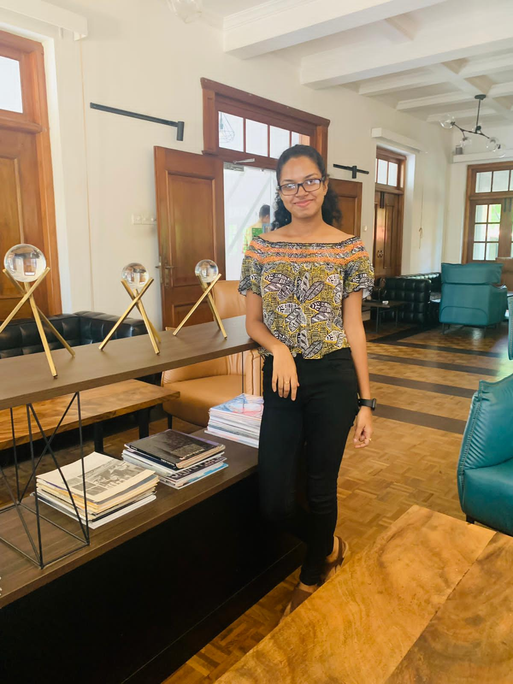
Madhubhashini A.D.P
IT20174576
BSc (Hons) in Information Technology (Specialization in Information Technology)
Design a smart solution that have capability to detect patients loved ones and relatives via face recognition in a way that patient is fully independent.
IT20174576 | Madhubhashini A.D.P. |TMP-23-081

Slide 42
Research Problem
Emotional impact on both the patient and the family members.
Lead to feeling of frustration, fear and anxiety.
Every time can’t get a 3rd party assistant for identify people
Patient may become withdrawn and socially isolated.
Burden on Caregivers.
Not having a proper assistive tool for make their life more independant
IT20174576 | Madhubhashini A.D.P. |TMP - 23-081

Slide 43
Research Gap
A
B
C
Recognition of familiar people with a mobile cloud architecture for Alzheimer patients [1]
Smart Phone Based Facial and Text Recognition Application (RICO) [2]
Alzheimer assistant: a mobile application using Machine Learning [3]
IT20174576 | Madhubhashini A.D.P. |TMP -23-081

Slide 44


Research Gap
Features | A | B | C | Solution
Real time image capturing option using smartphone camera
Screening the person information
Use a text-to-speech module to hear the information.
Special User Interface creation for dementia patients
filter a memory, related to captured person.
IT20174576 | Madhubhashini A.D.P. |TMP - 23-081

Slide 45
Create a model to detect the faces of individuals
Research Objectives
Train a object recognition that can filter Image of relevant person.
Improving the independence by designing a smart and effective solution for the Dementia patients to identify their loved ones by increasing their confidence to remember each member of their family.
Create a text-to speech mechanism to hear the information

Slide 46
Methodology

Slide 47
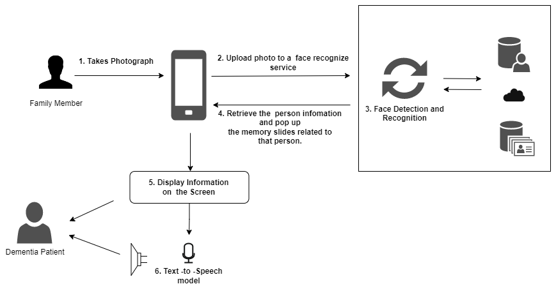
System Overview Diagram

Slide 48


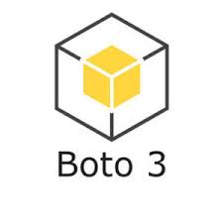

Tools and technologies
Reactnative
Python
AWS S3
Mangum
Boto3
Pandas
GitLab
Numpy
AWS Amplify
Urllib3
AWS Lambda

Slide 49
Evidences for the Completion

Slide 50
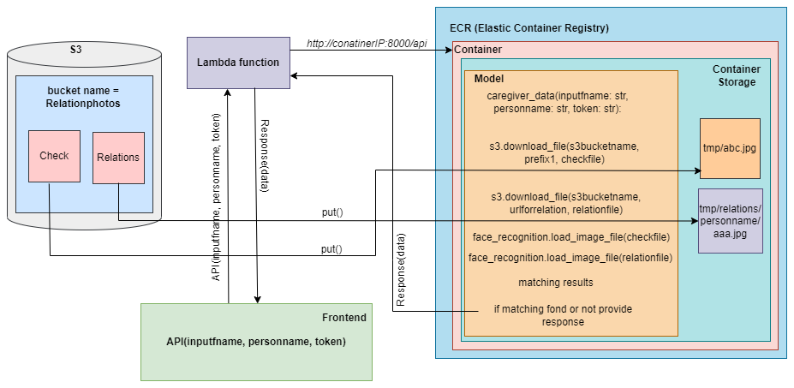
System Architecture

Slide 51
Face Recognition System
CNN used to detect and match the faces of individuals [4]
Deep neural network to generate numerical representation (Face encoding).
Face encoding capture unique characteristics.
Euclidean distance used to compute the similarity between the face encoding.

Slide 52
Tasks to be completed
● Integrate and test the whole system together
● Commercialize the application
IT20174576 | Madhubhashini A.D.P. |TMP -23-081

Slide 53
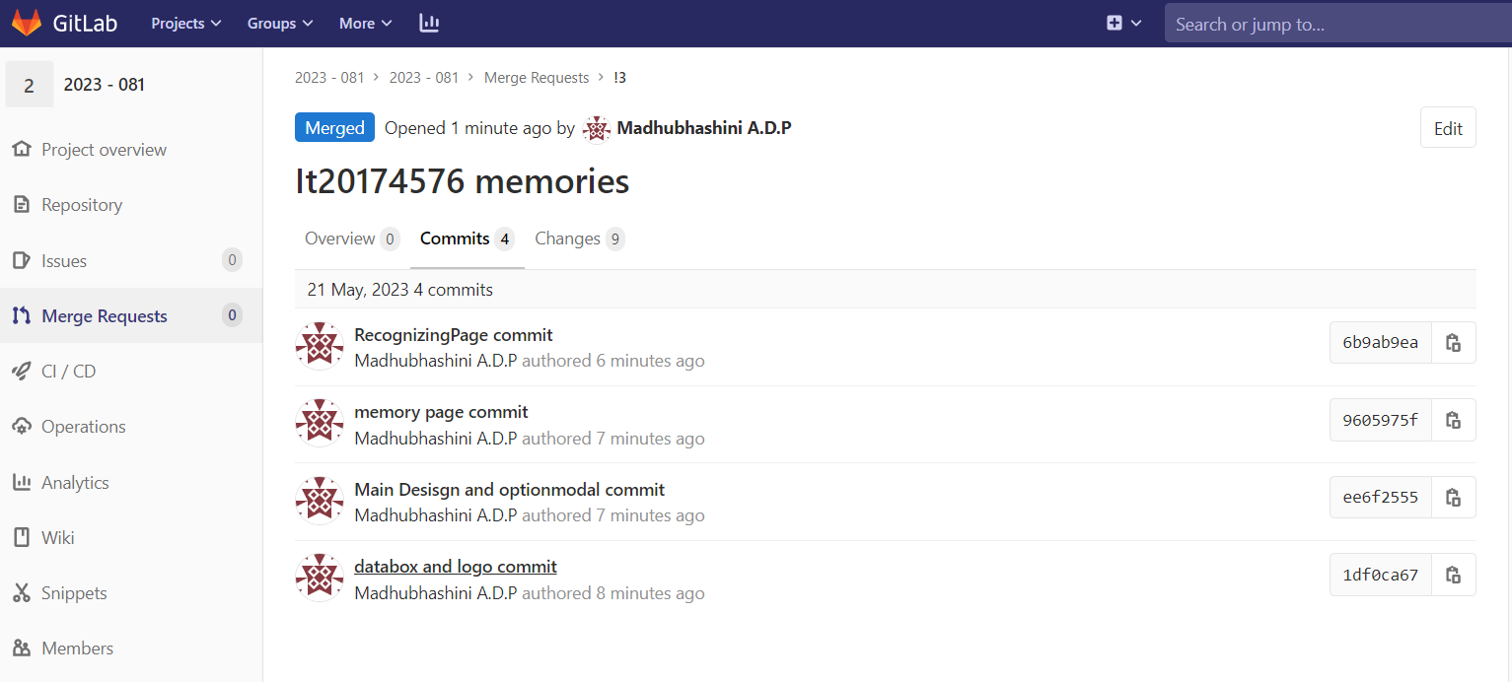
Gitlab Repository
IT20174576 | Madhubhashini A.D.P. |TMP - 23-081

Slide 54
Gantt Chart
IT20174576 | Madhubhashini A.D.P. |TMP23-081

Slide 55
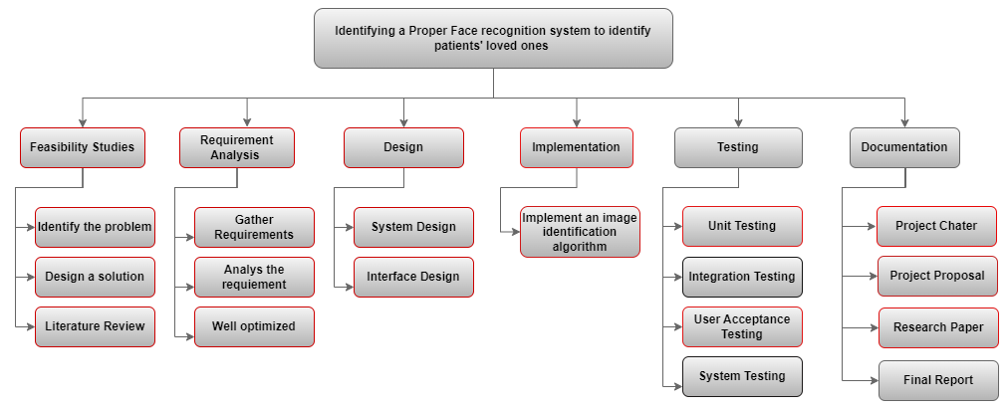
Work Breakdown Chart

Slide 56
References
[15] [1] H. M. Fardoun, A. A. Mashat, and J. Ramirez Castillo, “Recognition of familiar people with a mobile cloud architecture for Alzheimer patients,” Disabil Rehabil, vol. 39, no. 4, pp. 398–402, Feb. 2017, doi: 10.3109/09638288.2015.1025992.
[4 [2] Sadjad University of Technology, Institute of Electrical and Electronics Engineers. Iran Section., and Institute of Electrical and Electronics Engineers, ICEE 2018 : 2018 26th Iranian Conference on Electrical Engineering : Sadjad University of Technology, 8-10 May 2018.
[3] N. Aljojo et al., “Alzheimer assistant: a mobile application using Machine Learning,” Revista Română de Informatică și Automatică, vol. 30, no. 4, pp. 7–26, Dec. 2020, doi: 10.33436/v30i4y202001tant: a mobile application using Machine Learning,” Revista Română de Informatică și Automatică, vol. 30, no. 4, pp. 7–26, Dec. 2020, doi: 10.33436/v30i4y202001
[4] M. M. Kasar, D. Bhattacharyya, and T. H. Kim, “Face recognition using neural network: A review,” International Journal of Security and its Applications, vol. 10, no. 3, pp. 81–100, 2016, doi: 10.14257/ijsia.2016.10.3.08.
[5] Institute of Electrical and Electronics Engineers and PPG Institute of Technology, Proceedings of the 5th International Conference on Communication and Electronics Systems (ICCES 2020) : 10-12, June 2020.

Slide 57
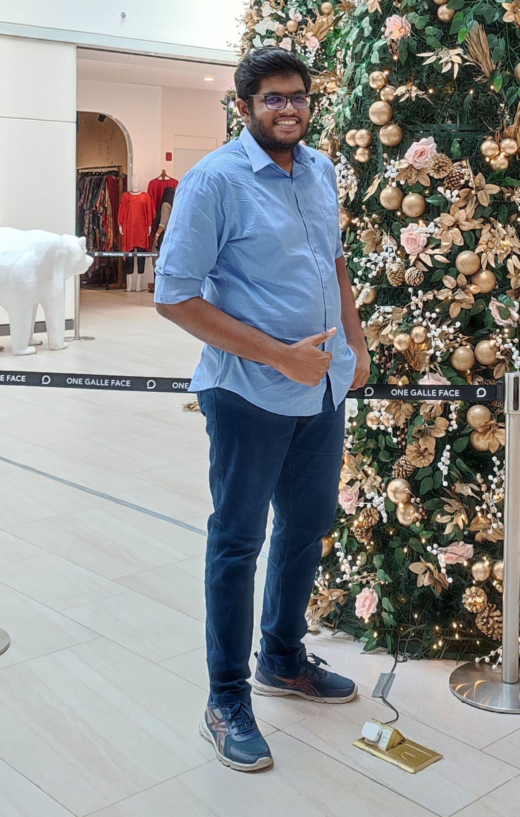
Kachchakaduwa E.U
IT20230388
BSc (Hons) in Information Technology (Specialization in Data Science)
Providing a smart solution for wandering behaviour of dementia patients by inventing a tracking mechanism to track locations while establishing safe zones and analyzing their movement patterns for future predictions.
IT20230388 | Kachchakaduwa E.U. | 2023-081

Slide 58
Research Problem
Inability to memorize all the activities and places that visit
Caregivers cannot prioritize their supervision on patinet all the time
50% of the Dementia patients dies and get immobilized due to wandering
Inability to spend money on extra equipment due to moderate and poor economic level
Existing tools lacks accuracy, efficiency and simplicity
No ways to analyze patients history and predict future movements
IT20230388 | Kachchakaduwa E.U. | 2023-081

Slide 59
Research Gap
Research A
Research B
Research C
IoT-Based Wearable Devices for Patients Suffering from Alzheimer Disease [1]
iWander: An Android Application for Dementia Patients [2]
Real-time Location Tracker for Critical Health Patient using Arduino, GPS Neo6m and GSM Sim800L in Health Care [3]
IT20230388 | Kachchakaduwa E.U. | 2023-081

Slide 60
 | A | B | C | Solution
Track the current location of the patient and monitor movement and speed constantly
Establish safe zones and change them according to the whereabouts at the time by caregivers
Analyze patient’s historical records and predict future movements
Alerting and alarming system for emergencies
IT20230388 | Kachchakaduwa E.U. |TMP-23-081

Slide 61
Inventing a mechanism to constantly track real-time locations of patients and maintain communication with caregiver.
Research Objectives
Create a system to establishing safe zones with customizable options while giving alerts to the caregivers in emergencies.
Providing a smart solution for wandering behaviour of dementia patients by inventing a tracking mechanism to track locations while establishing safe zones and analyzing their movement patterns for future predictions
Build a predictive model to analyze patient’s historic records and predict future movements.
IT20230388 | Kachchakaduwa E.U. | 2023-081

Slide 62
Methodology
IT20230388 | Kachchakaduwa E.U. | 2023-081

Slide 63
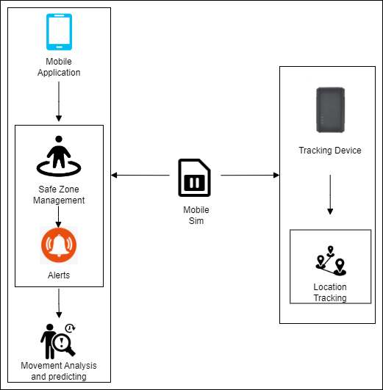
System Diagram
IT20230388 | Kachchakaduwa E.U. | 2023-081

Slide 64

Tools and Technologies
React Native
GitLab
Firebase
Python
JavaScript
IT20230388 | Kachchakaduwa E.U. | 2023-081

Slide 65
Evidences for the Completion
IT20230388 | Kachchakaduwa E.U. | 2023-081

Slide 66
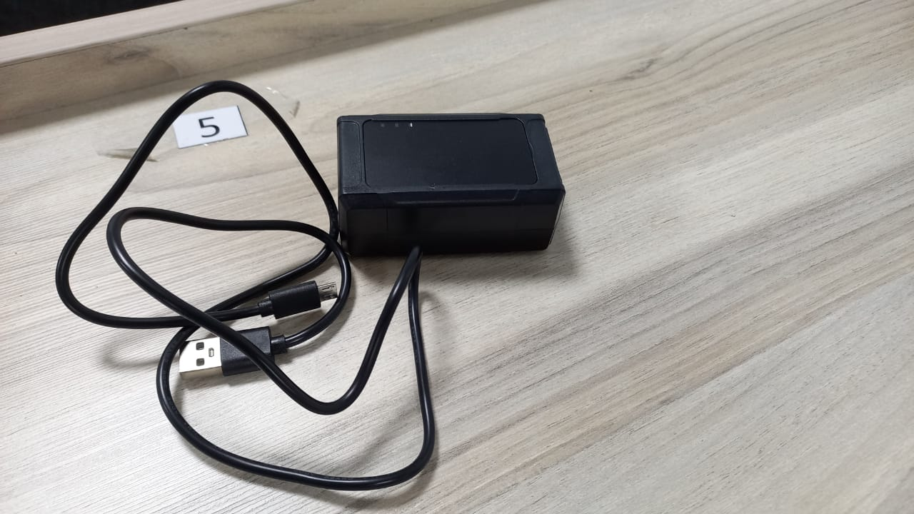
Portable Location Tracker

Slide 67
Location Tracker and models
Geofencing
A method of defining virtual barriers on a real geographical location [4]. Can use to define safe zones and trigger alerts when patients enter or exit the defined areas.
Random Forest Algorithms and Decision Tree Algorithms provide predictions with high accuracies by combining multiple classifiers for problem solving [5]
Artificial Neural Network (ANN)
IT20230388 | Kachchakaduwa E.U. | 2023-081

Slide 68
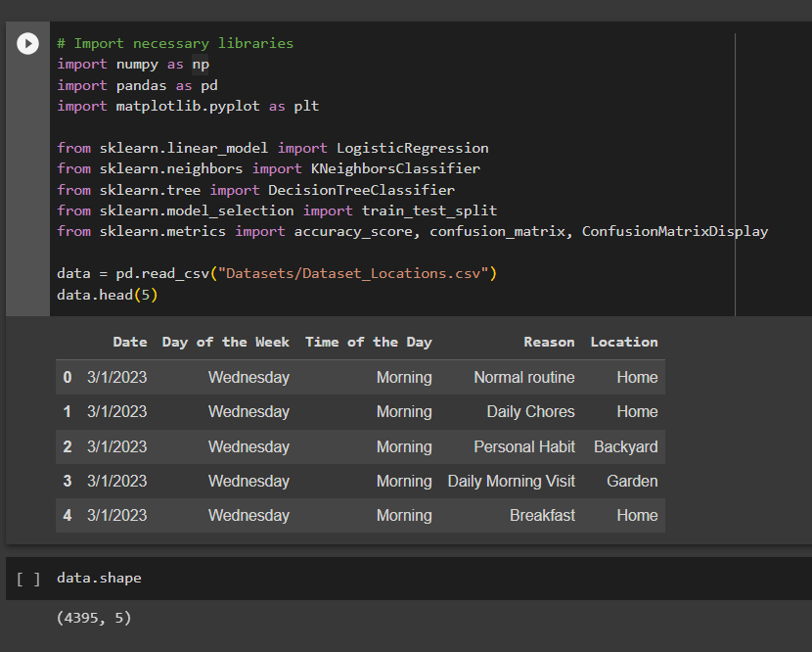
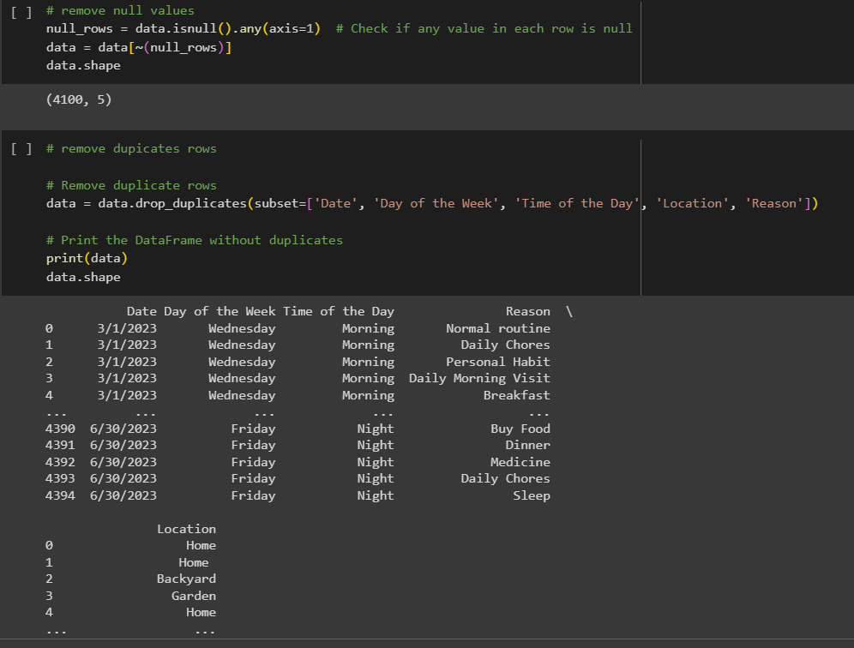
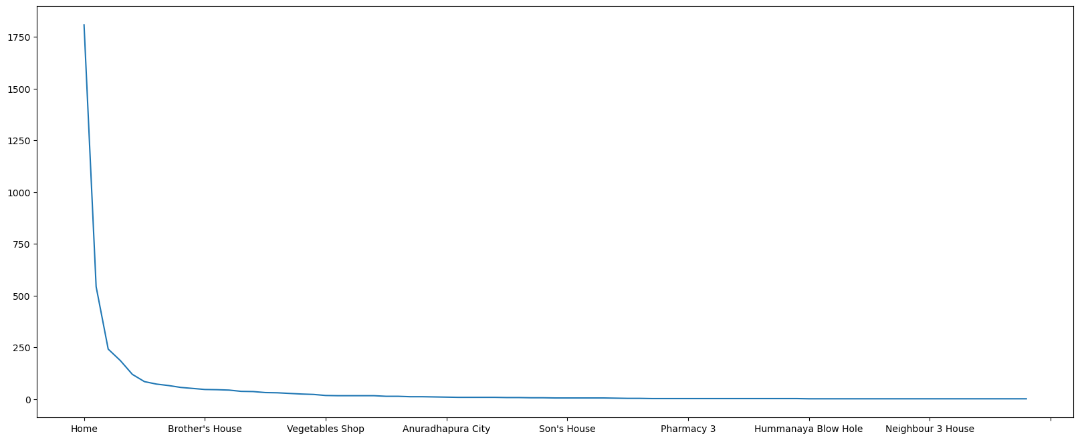
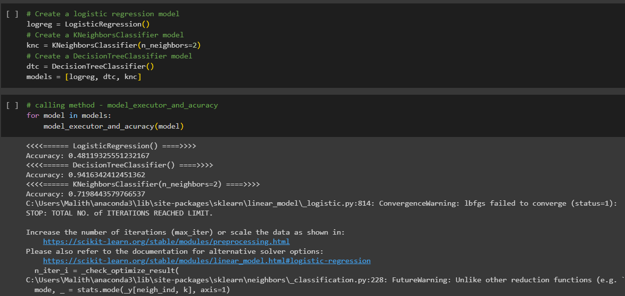
Decision Tree Algorithm
IT20230388 | Kachchakaduwa E.U. | 2023-081

Slide 69
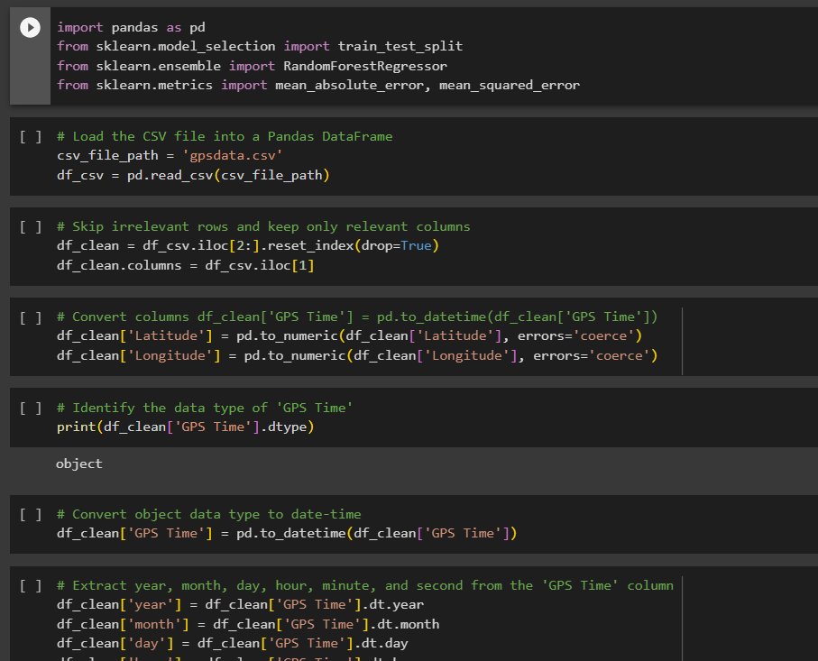
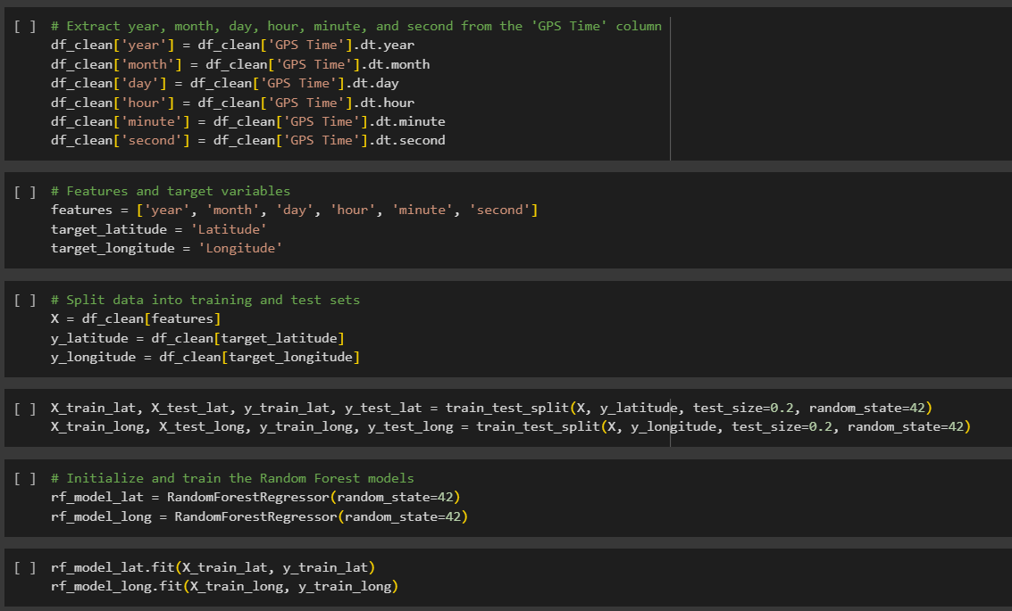
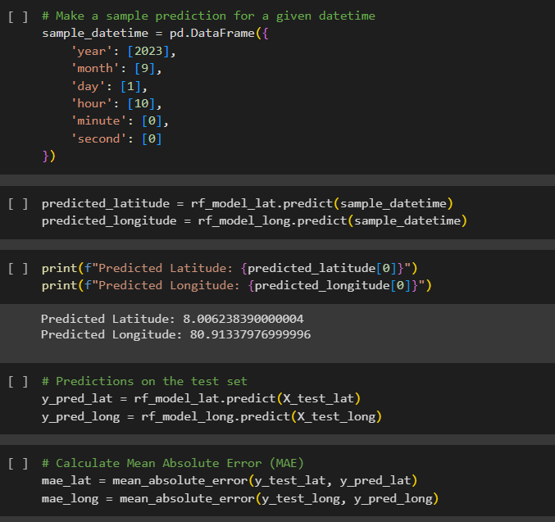
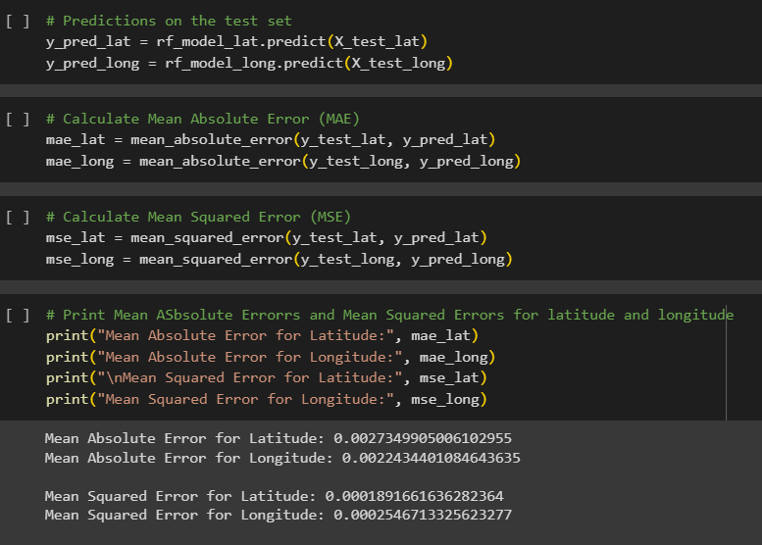
Random Forest Algorithm
IT20230388 | Kachchakaduwa E.U. | 2023-081

Slide 70
Tasks to be completed
Integrate and test the whole system together
Commercialize the application
IT20230388 | Kachchakaduwa E.U. | 2023-081

Slide 71
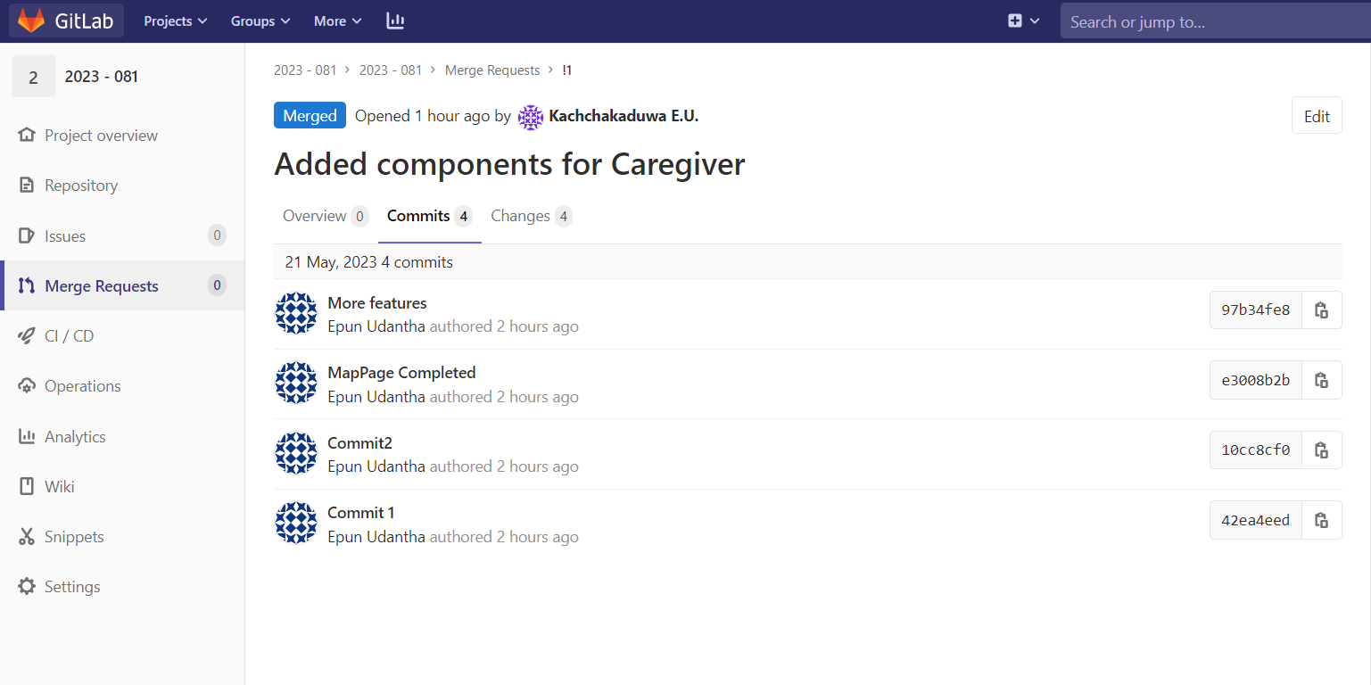
Gitlab Repository
IT20230388 | Kachchakaduwa E.U. | 2023-081

Slide 72
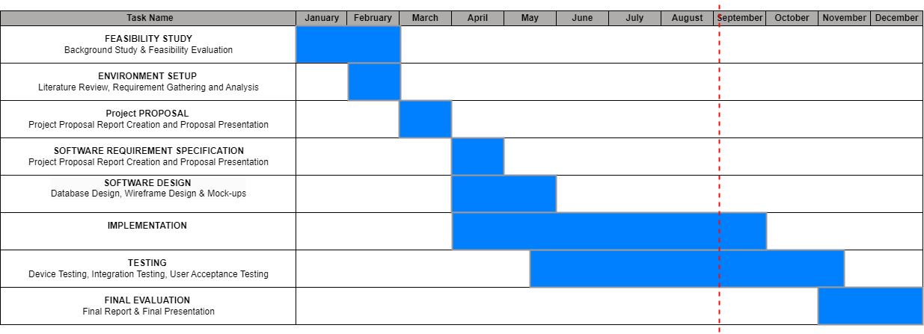
Gantt Chart
IT20230388 | Kachchakaduwa E.U. | 2023-081

Slide 73
Work Breakdown Structure
Providing a smart solution for wandering behaviour of dementia patients by inventing a tracking mechanism to track locations while establishing safe zones and analyzing their movement patterns for future predictions
Feasibility Study
Requirement Analysis
Design
Implementation
Testing
Documentation
Identifying the problem
Gather Requirements
System Design
Implement a real-time location tracking system
Unit Testing
Project Charter
Design a Solution
Analize Requirements
Interface Design
Implement a safe zones monitoring system
Integration Testing
Project Proposal
Literature Review
Well Optimized
Implement a future movements predictive model
User Acceptance Testing
Research Paper
System Testing
Final Report
IT20230388 | Kachchakaduwa E.U. | 2023-081

Slide 74
References
[1] Waleed Salehi, Gaurav Gupta, Surbhi Bhatia, Deepika Koundal, Arwa Mashat, Assaye Belay, "IoT-Based Wearable Devices for Patients Suffering from," 2022.
[2] Frank Sposaro, Justin Danielson, Gary Tyson, "iWander: An Android Application," 2010.
[3] Pratik Kanani, Dr. Mamta Padole, "Real-time Location Tracker for Critical Health," 2020.
[4] Aagy Paulose, Aswathy K S, Nurjahan V A, "Smart Geofencing: An Inventive Mobile Marketing Strategy," p. 2019.
[5] [Online]. Available:https://www.simplilearn.com/tutorials/machine-learning-tutorial/random-forest-algorithm/.
IT20230388 | Kachchakaduwa E.U. | 2023-081

Slide 75
Spread the word around Dementia Individuals
Obtain regulatory approval
COMMERCIALIZATION
Sponsor content creators with the same disability
Provide ongoing support

Slide 76
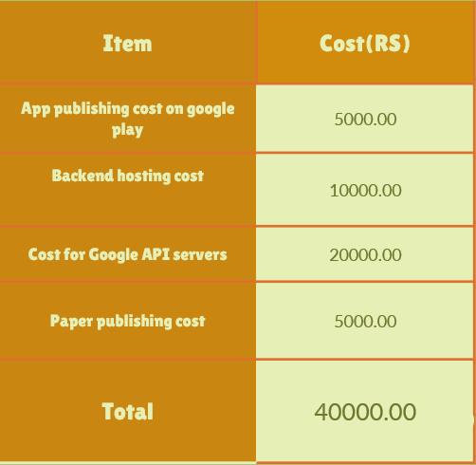
Budget for overall system

Slide 77

Demo Time

Slide 78
THANK YOU!

